Slide 1
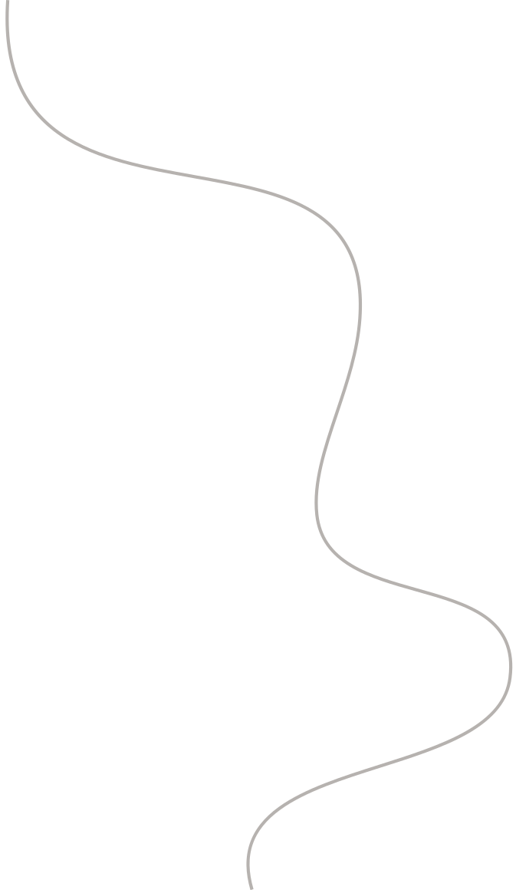


Aero-Engine Blade
Defect Detection
John Alber, 8976716
Simardeep Singh, 8976948

Slide 2
Table of content
Introduction
Libraries
Data Preparation
Model Development
Training
Evaluation
Performance Analysis
GUI Development
Challenges Faced

Slide 3
Introduction
This project focuses on detecting and classifying defects in aero-engine blades using advanced machine learning techniques. It employs a deformable convolutional neural network (Deformable ConvNet) that adapts to geometric transformations, making it suitable for handling complex image patterns. The goal is to identify various types of blade defects such as scratches, dots, creases, and damage. This approach aims to enhance the reliability and efficiency of defect detection processes in aerospace engineering. The project could be critical for maintenance and quality control in the aerospace industry.

Slide 4
Libraries
os
torch
glob
PIL
sklearn
seaborn
matplotlib
tkinter
numpy

Slide 5
Data Preparation
Image Loading
Image Transformation
Label Handling
Class Mapping
Data Representation

Slide 6
Model Development
The model development involved designing a convolutional neural network (CNN) architecture called DeformableConvNet. This architecture comprises two convolutional layers with max-pooling, followed by two fully connected layers. ReLU activation functions are applied after each layer to introduce non-linearity. The network takes RGB images as input and produces class predictions for the specified number of classes. The forward pass defines how input data flows through the layers to generate output predictions. Overall, the DeformableConvNet model is tailored for image classification tasks, offering flexibility and efficiency in feature extraction and classification.

Slide 7
Training
Training involves feeding the prepared data into the neural network and using a loss function and optimizer to minimize errors during prediction. Batch processing is managed using a custom collate function that filters out incomplete or invalid data points. The training process iteratively adjusts the model weights to improve accuracy and reduce loss, and is monitored for convergence.

Slide 8
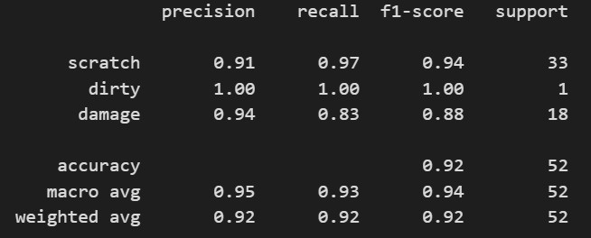
Evaluation
After training, the model is evaluated using a separate validation dataset to assess its performance. Metrics such as accuracy, precision, recall, and F1-score are calculated. The evaluation phase helps in understanding the effectiveness of the model under different conditions and is crucial for tuning model parameters to avoid overfitting and underfitting

Slide 9
Scratch: The model identifies 'scratch' with high precision (0.91) and recall (0.97), indicating it correctly labels most scratches and doesn't often confuse them with other defects. The F1-score is 0.94, suggesting a balanced performance between precision and recall for this class. The model encountered this defect 33 times in the dataset.
Dirty: The model performs perfectly on 'dirty', with precision and recall at 1.00, meaning it accurately identified all instances without any false positives or negatives. However, this is based on a single instance (support of 1), which is not enough to draw significant conclusions about the model's performance for this class.
Damage: For 'damage', the model has a precision of 0.94 and a recall of 0.83, resulting in an F1-score of 0.88. This suggests that while the model is quite precise in its predictions, it misses some actual cases of damage (lower recall). There were 18 instances of 'damage' in the dataset.

Slide 10
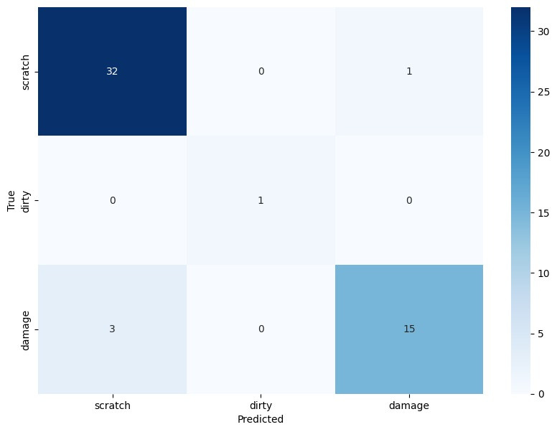
Performance Analysis
Scratch: The model predicted 'scratch' correctly 32 times but misclassified it as 'damage' once. It did not mistakenly identify any 'scratch' as 'dirty'.
Dirty: There was only one instance of 'dirty' in the dataset, and the model accurately predicted it. There were no false predictions associated with 'dirty'.
Damage: Out of the 18 cases, the model correctly identified 'damage' 15 times but incorrectly predicted 'scratch' for the remaining 3 cases.

Slide 11
GUI Development
A GUI is developed using tkinter, allowing users to interact with the model easily. The GUI enables users to upload images, run defect detection, and view results directly. This interface is designed to be user-friendly, making the technology accessible to technicians and engineers without requiring them to interact directly with the underlying code.

Slide 12
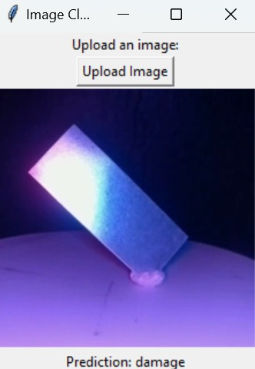
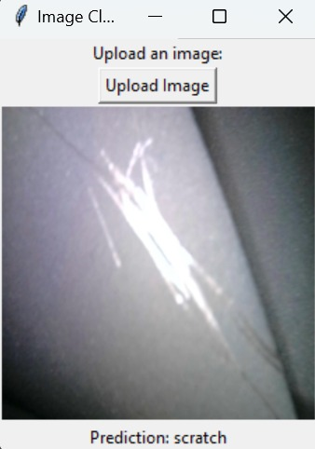
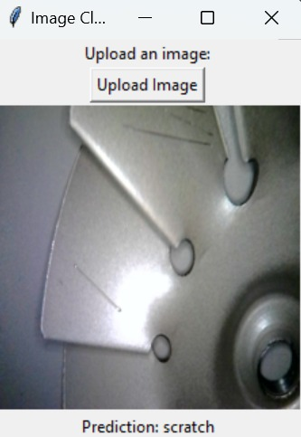

Slide 13
Problem Faced
Class Imbalance: Some defects, like 'dirty', are underrepresented in the dataset, leading to a bias towards more frequent defect types.
Label Inaccuracies: Errors in label mapping and missing labels introduce noise, hindering the model’s learning of correct patterns.
Overfitting Risk: The small size of the dataset could cause the model to overfit, reducing its effectiveness on new data.

Slide 14
Thank
You

